Slide 1
Advanced Project Schedule Risk Analysis
Presented by
David T. Hulett, Ph.D.
Hulett & Associates, LLC
Project Management Consultants
Los Angeles, CA USA
info@projectrisk.com
www.projectrisk.com
(310) 476-7699
© 2002 Hulett & Associates, LLC.
Notes:
Project Risk Analysis and Management Three-Day Course
Presented by
David T. Hulett, Ph.D.
Senior Vice President
Project Risk Management
© 2000 International Institute for Learning, Inc.
For
Ericsson Telecommunicatie b.v.
June 5-7, 2000

Slide 2
Agenda
Introduction
Activity distributions and data entry
Risk along a schedule path
Risk of parallel paths -- the “Merge Bias”
Effect of limited resources
Effect of constraints

Slide 3
Agenda (continued)
Sensitivity Analysis
“Risk Critical Path”
Risk in statused schedules
Probabilistic branching
Conditional branching
Correlation

Slide 4
Pitfalls in Relying on CPM
CPM network scheduling is deterministic
Single-point activity durations
OK only if everything goes according to plan
CPM durations are really probabilistic assessments
There are no “facts” about the future

Slide 5
Objectives of a Schedule Risk Analysis
Improve the accuracy of the schedule dates
Validate the CPM or contract dates
Establish a schedule contingency
Identify the risk-driving events
Communicate about and understand the project
Continuously monitor changing schedule risk

Slide 6
Three Basic Components of
Schedule Risk Analysis
Risk of the activity duration
30d
Design
Unit 1

Slide 7
Three Basic Components (continued)
Risk of duration along a Path
Design Unit 1
Build Unit 1
Finish
Start

Slide 8
Three Basic Components (continued)
Risk at a point where parallel paths merge
"Merge Bias"
Design Unit 1
Build Unit 1
Start
Finish
Design Unit 2
Build Unit 2

Slide 9
Risk of an Individual Activity
Simple activity duration estimates are risky
Activity duration risk is similar to cost element risk
30d
Design
Unit 1

Slide 10
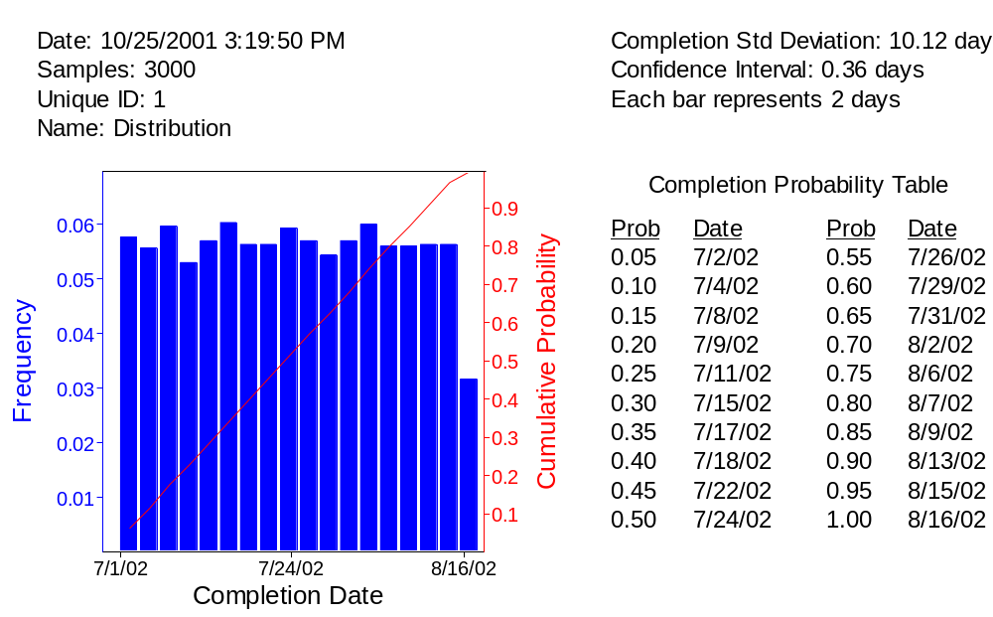
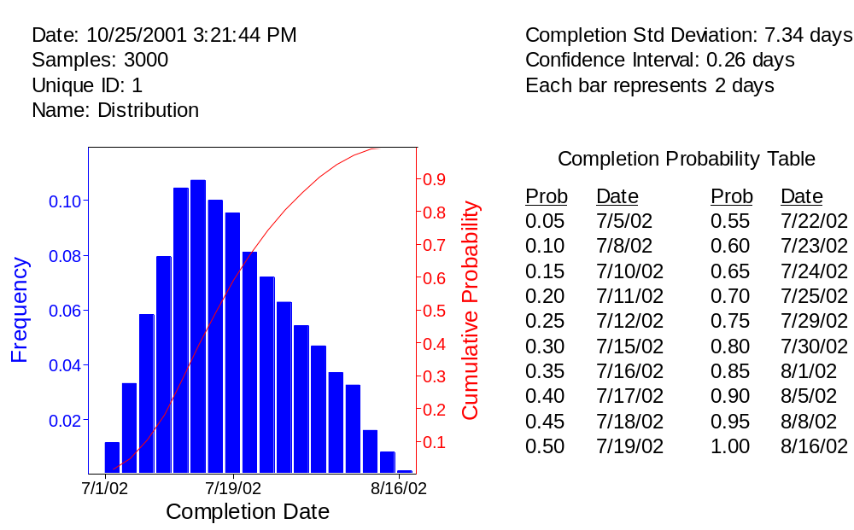
4 Common Probability Distributions
Uniform
Triangular

Slide 11
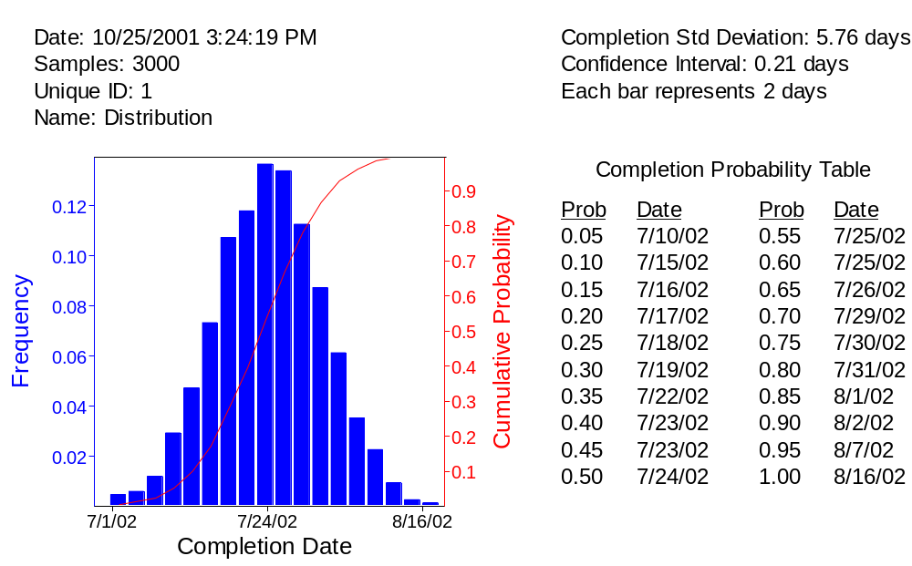
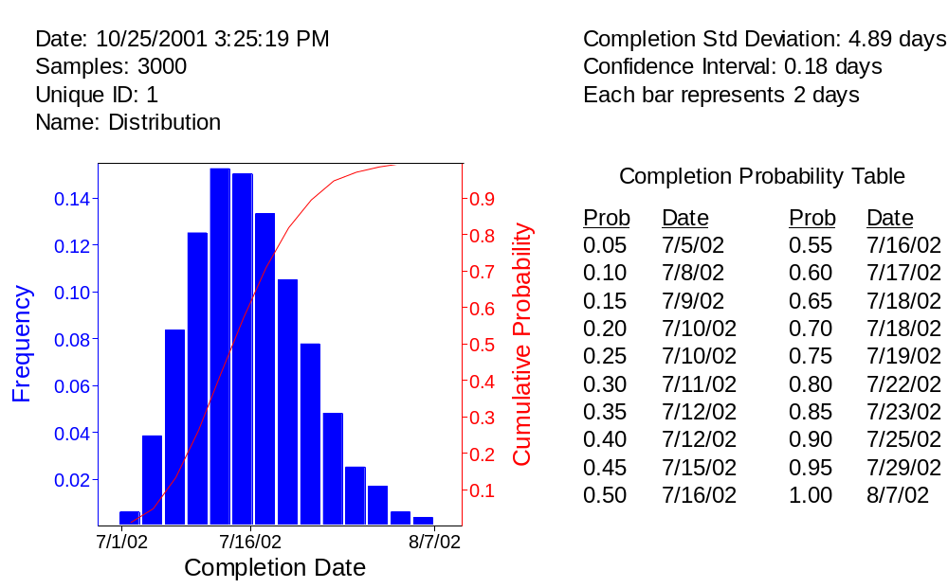
4 Common Probability Distributions (continued)
Normal
BETA

Slide 12
Data Collection
Assemble subject matter experts including people on the project
Ask them to review the highest-risk items
  Pareto analysis – top 30% + of the elements contains most of the risk
Experts review elements
  What areas are risky? What causes the risk?
  What are the optimistic (low), most likely and pessimistic (high) durations for those elements?
  Baseline schedule may not be the “most likely” duration

Slide 13
Data Collection (continued)
Judgmental estimates. Do not have historical data
Motivational biases
  Want to make the project look good – project manager
  Do not want to be seen as unable to do the job
Cognitive biases
  Anchoring and Adjusting – underestimate risk
  Availability – focus on what is dramatic or current
  Representative – what does the information represent
  Unthinkable consequences

Slide 14
Data Collection (continued)
Conduct the “Risk Interview” with facilitator
Challenge the teams’ ranges
Identify the places where failure might occur – tests fail
  Likelihood of failure
  Time to diagnose, plan and execute response, retest
Document the issues and findings

Slide 15
Data Entry & Data Editing
Data can be entered by task
Data can be entered as common % ranges
Entering or editing in Excel and copying over is easy
Select activities manually or by a code in some field, to indicate similarities among activities
  E.g. all test activities get –25% and +100%
  E.g. all fabrication activities get –30% and +40%
  This is called “risk banding”

Slide 16
Risk Along a Contiguous Schedule Path
Path risk is the combination of the risks of its activities
This is also like cost risk, adding risks of individual cost elements to get the risk of the total
Design Unit
Build Unit
Test Unit
Start
Finish

Slide 17
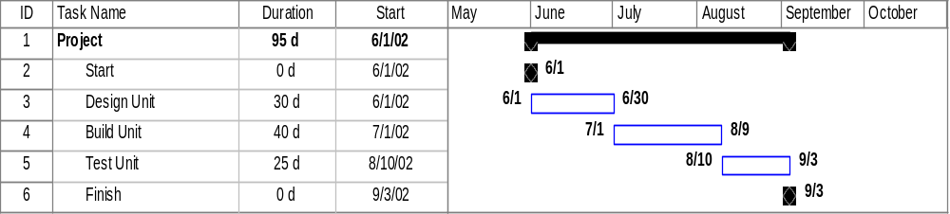
Really Simple Schedule
This schedule finishes on September 3
  7-day weeks, like a model changeover, refinery turnaround
If we can get into trouble with this simple schedule, we can get into trouble with real project schedules

Slide 18
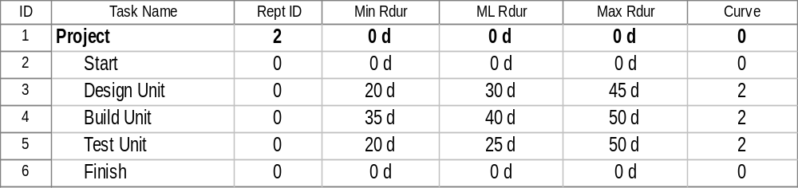
Add Duration Risk to the Schedule using Triangular Distributions
We are using Risk+ from C/S Solutions. Other packages are @RISK from Palisade and Monte Carlo from Primavera. PERTMASTER Professional and Open Plan Professional have simulation capabilities built-in.

Slide 19
What is a Simulation?
How do you find total project results?
  Cannot add distributions
  Must combine distributions
Combining distributions using simulation
  Almost all possible combinations of durations
  “Perform” the project many times
Notes:
The traditional approach to finding total project cost is to add up estimates of each cost element. Since a risk analysis portrays the costs as probability distributions, or “shapes,” simple arithmetic summation will not be possible.
David will point out that, since many combinations of elements’ costs are possible, we must conduct a simulation to represent each possible combination in our total project cost distribution.

Slide 20
Combine Distributions by Simulation
Monte Carlo simulation
  Very General
  50-year old method
Computer “performs” project many times
  Exercise is a “simulation”
  Each calculation is an “iteration”
Brute force solution
  All combinations of possible costs or durations
Notes:
MOST COMMON IS A MONTE CARLO SIMULATION
AS THE NAME IMPLIES, IT WILL RELY ON RANDOM ACTS
THIS IS A VERY GENERAL METHOD
A STRONG 50 YEAR HISTORY
BECOMING MORE COMMON NOW AS SOFTWARE IS IMPROVED
IN THE MOST RECENT REVISION OF THE PMBOK (R) GUIDE OF PMI WE MADE MORE OF A POINT OF TALKING ABOUT THIS MODERN TECHNIQUE OF QUANTITATIVE RISK ANALYSIS

Slide 21
Number of Iterations
How many iterations should we do?
  Accuracy demanded
  2,500 is sufficient
  Final reports, ==> 10,000 iterations
Latin Hypercube
  Stratified sampling for more accuracy
Notes:
HOW MANY TIMES DO WE NEED TO COMPUTE THE TOTAL PROJECT COST?
I HAVE HEARD OF PEOPLE ITERATING 30,000+
THIS IS NOT NECESSARY
2,500 SHOULD BE ENOUGH FOR A SIMPLE SUMMATION COST RISK
FOR FINAL REPORTS, MAYBE 10,000 TO GET SMOOTH CURVES

Slide 22
Common Sense Results can be Wrong!
“Well, if we just use the right “most likely” durations in our schedules we will get the most likely completion date. Right?”
Wrong!

Slide 23
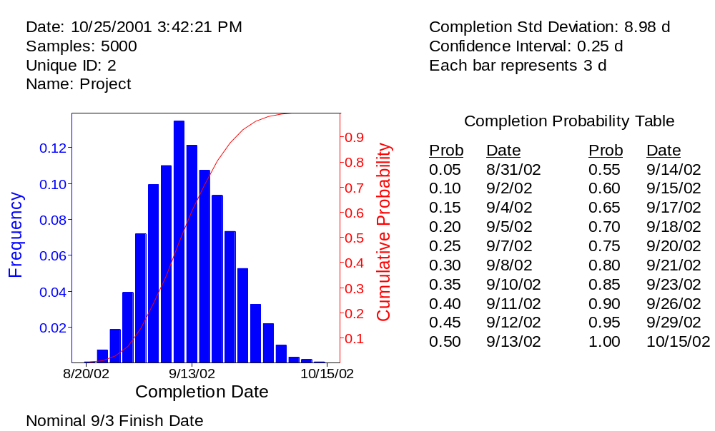
Monte Carlo Simulation Results for Really Simple Schedule
CPM date is not even the most likely – That’s about 9/10
80% Target is 9/21
CPM date 9/3 is <15% Likely to be met

Slide 24

Risk at Merge Points:
The “Merge Bias”
Many parallel paths merge in a real schedule
Finish driven by the latest converging path
Merge Bias has been understood for 40 years
"OUCH!"
Design Unit 1
Build Unit 1
Start
Finish
Design Unit 2
Build Unit 2

Slide 25
Much Schedule Overrun Risk
Occurs at Merge Points
Complex schedules have activities in parallel
Merge points are important events
  Completion of the project
  Major design review
  Beginning integration and test
Delay on any path may potentially delay the project
This extra risk is called the “Merge Bias”

Slide 26
Example of Merge Bias
Example of the Merge Bias
  Make three project paths that are exactly the same
  Same durations
  Same risks
  Start on the same day
CPM says this project, too, finishes on June 17
Is this reasonable? Is this project just as risky as the one-path project? More risky? Somehow less risky?

Slide 27
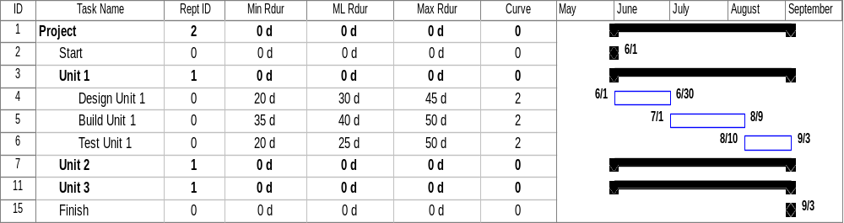
This Schedule has
Three Equal Parallel Paths
Two paths are collapsed
Each path has exactly the same structure

Slide 28
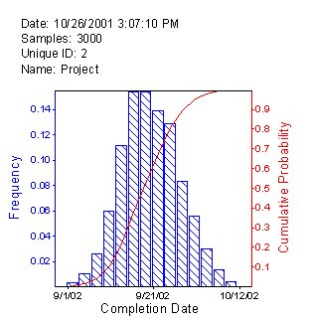
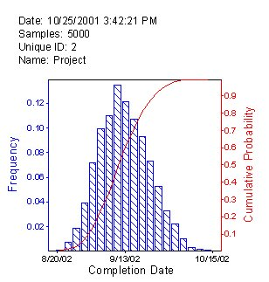
Evidence of the Merge Bias
Three Path Schedule
One Path Schedule

Slide 29
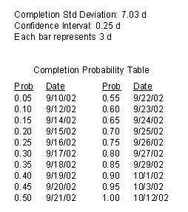
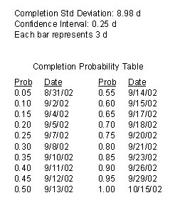
Evidence of Merge Bias (continued)
Three Path Schedule
One Path Schedule

Slide 30
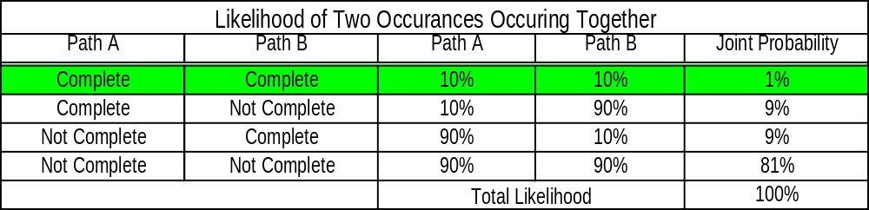
What’s Happening Here?
Likelihood of Two Events at Once
Success is only in the green area
Other scenarios represent failure

Slide 31
Resource Problems
With real projects resources may be scarce
Unless resources are added, some activities must be delayed or stretched out
Critical Path Method (CPM) scheduling allows resource leveling and delays the project
Each iteration is a CPM solution
Each iteration must be resource-leveled

Slide 32
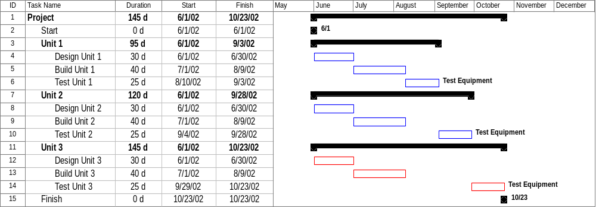
What Happens if Resources are Limited?
Limited Test Equipment means delaying Units 2 & 3
Resource leveling delays completion from 9/3 to 10/23

Slide 33
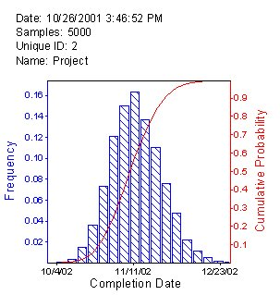
Leveling Resources and Schedule Risk
Resource Leveled Simulation
Simulation Not Resource Leveled

Slide 34
Imposing Constraint Dates on the Project Finish Date
Constraints are placed on the important delivery dates
This can help CPM scheduling
  Negative float develop feasible schedules
Constraints are also used to make the project show success
Constraints left in the schedule frustrate risk analysis of the very items you care about

Slide 35
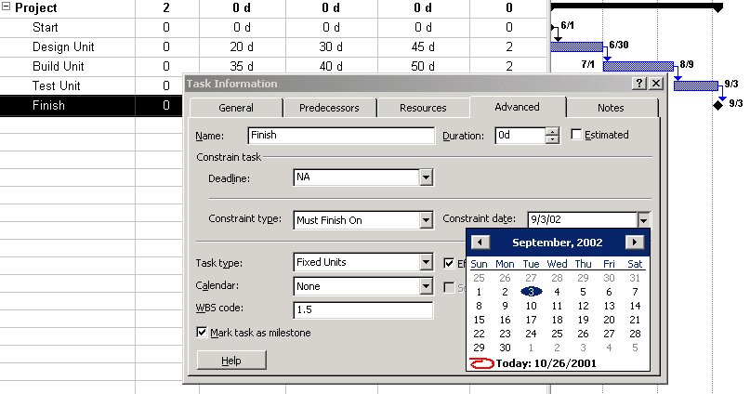
Imposing Constraint Dates on the Project Finish Date (continued)
We leave the Must Finish On 9/3/02 constraint on the finish milestone

Slide 36
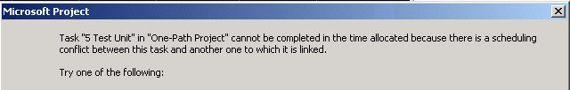
Effect of a Not Later Than Or Must Finish On Constraint on the Simulation
Project gives you a message about the constraint
  This tells you that you have a constraint that is binding
You can complete if you manually click the message
If you turn off messages you will never know whether you have constraints that bind
Do Not Turn Off the Scheduling Messages

Slide 37
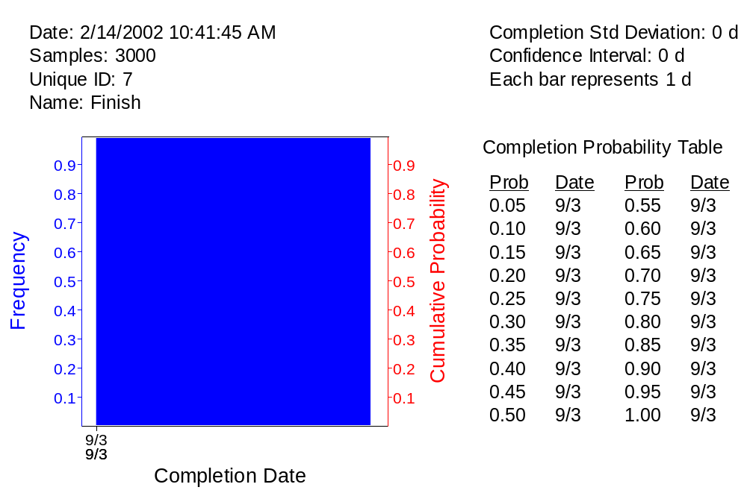
Effect of a Must Finish On Constraint
If the results are captured at the milestone, the results are very uninteresting and uninformative

Slide 38
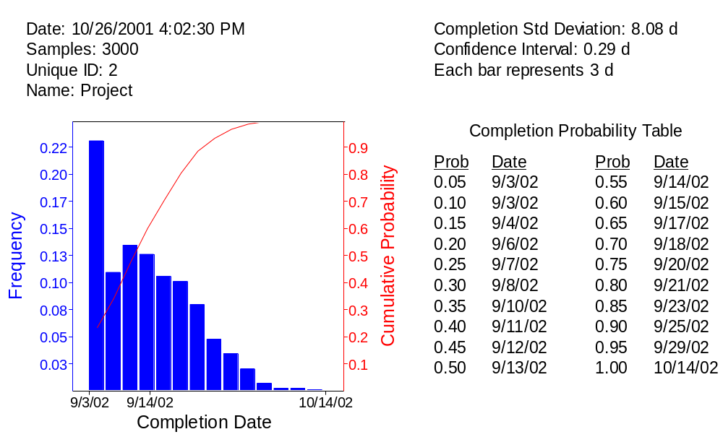
Effect of “Must Finish On” Constraint
If the results are gathered at the summary task, the results
show only the “threat” side of the distribution
Cannot go Earlier since the Milestone does not Move

Slide 39
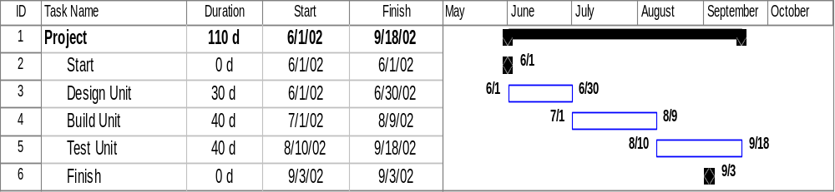
“Must Finish ON” will have Different Results if you use Summary Bar or Milestone
What’s happening here? MS Project allows the
predecessor activities extend PAST the FIXED milestone
Even if finish milestone might not be later, Test Unit can be, in Project. We’re using the Project summary bar for our results

Slide 40
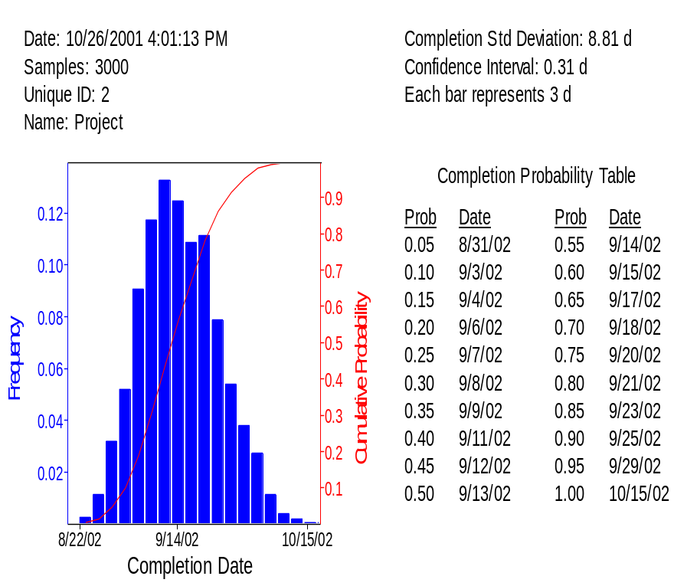
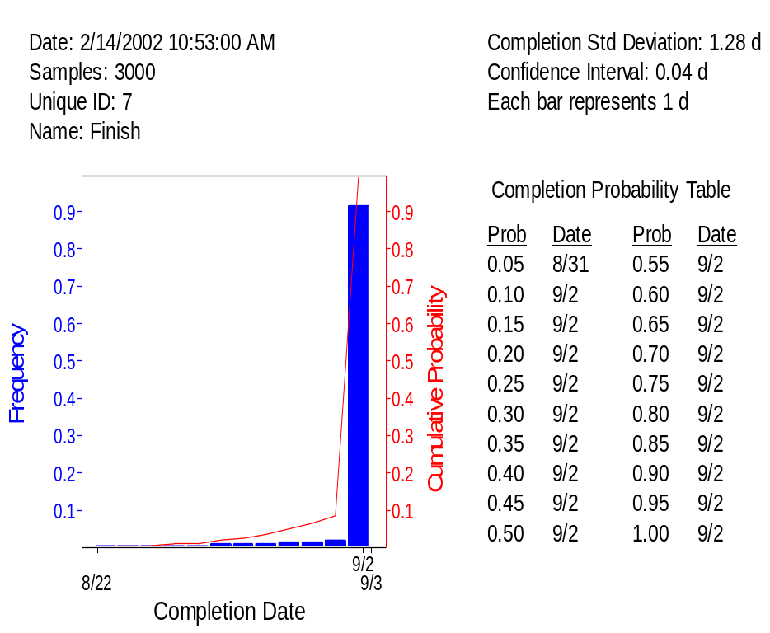
Effect of “Finish Not Later Than” Constraint
Collecting data at the Summary Bar – Correct because MS Project allows activities to exceed the date
Collecting data at the Finish Milestone – Incorrect because Constraint holds

Slide 41
What are the Highest Risk Activities?
We do not know in advance which path will delay the project
Monte Carlo simulation tells us which is most likely
  Activities on critical path in most iterations
Path delaying the project may not be the critical path identified by CPM
This is “Schedule Critical” not Technically Critical
  Combination of risk and low float (slack)

Slide 42
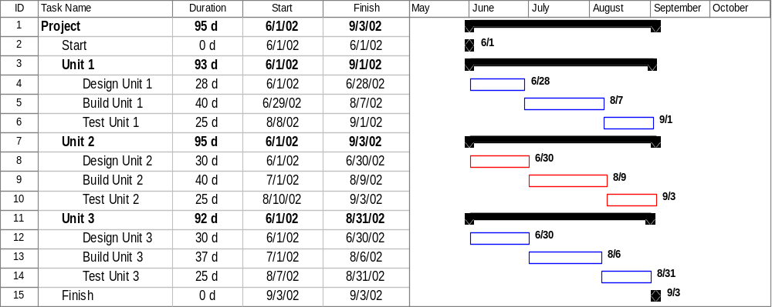
What are the Highest-Risk Activities?
Units 1 & 3 are Shorter and Not Risk Mitigated
“Critical” Unit 2 is Identified for Risk Mitigation

Slide 43
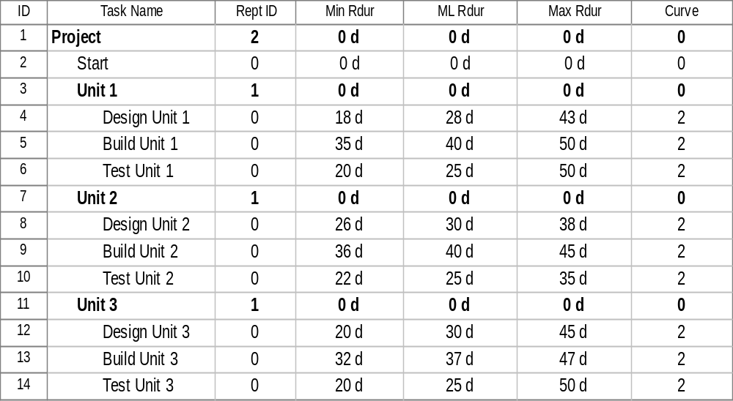
What are the
Highest-Risk Activities? (continued)
Unit 2 is Closely Managed but Units 1 & 3 still Have Risk

Slide 44
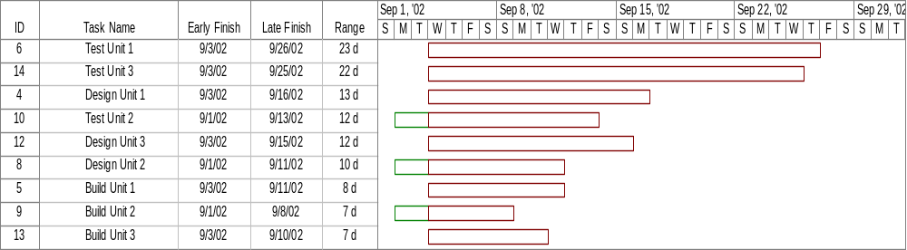
Use Sensitivity Analysis First
Even if Units 1 & 3 are shorter, Unit 2 keeps schedule from shortening
Opportunities only in the CPM critical path for Unit 2

Slide 45
Risk Criticality of Activities
Risk Criticality is the likelihood that an activity will be on the path that delays the project
  Activity may not be technically risky
  Activity may not be risky, but path is
Percentage of iterations on the critical path

Slide 46
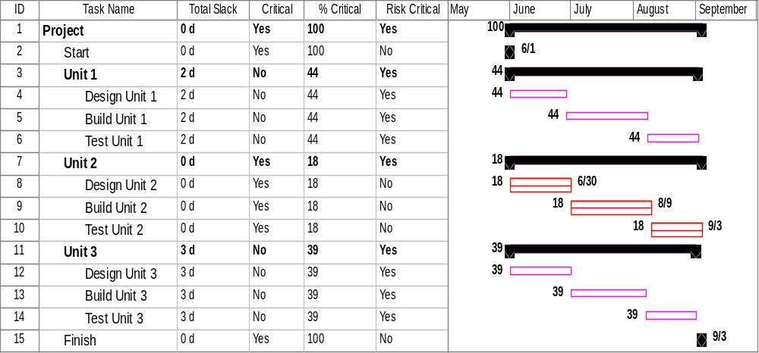
Risk Critical GANTT Chart
The “Critical Path” has been managed and is only 18% likely to delay the project. Now turn attention to Units 1 & 3

Slide 47
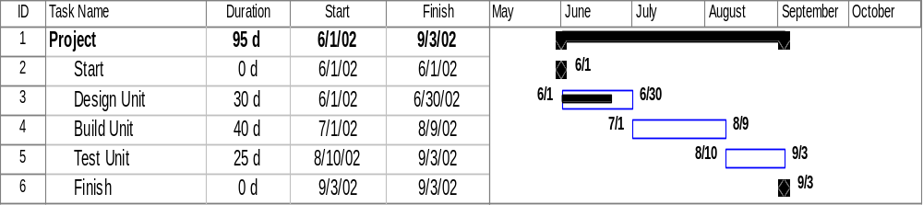
Handling Statused Activities
Risk range on remaining duration – Actuals are not risky
Hence the “Min Rdur,” ML Rdur,” “Max Rdur”
What happens when an activity has actual progress?
  Design Unit has 70% complete, 9 days to go
  On track to finish on 9/3

Slide 48

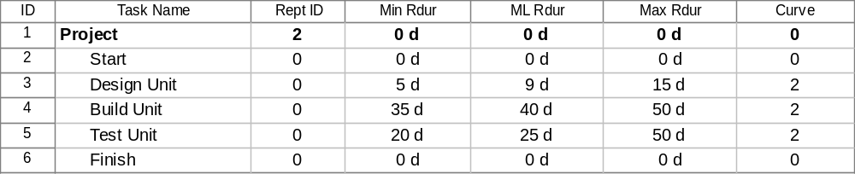
Adjusting the Durations for
15 days of Actual Progress
Leave original risk ranges even though Design has progress? NO!
With only 9 days to go on Design, risk ranges adjusted to remaining duration. YES!

Slide 49

Handling Statused Activities (continued)
If you do not change the risk ranges, expected completion is 10/5

Slide 50
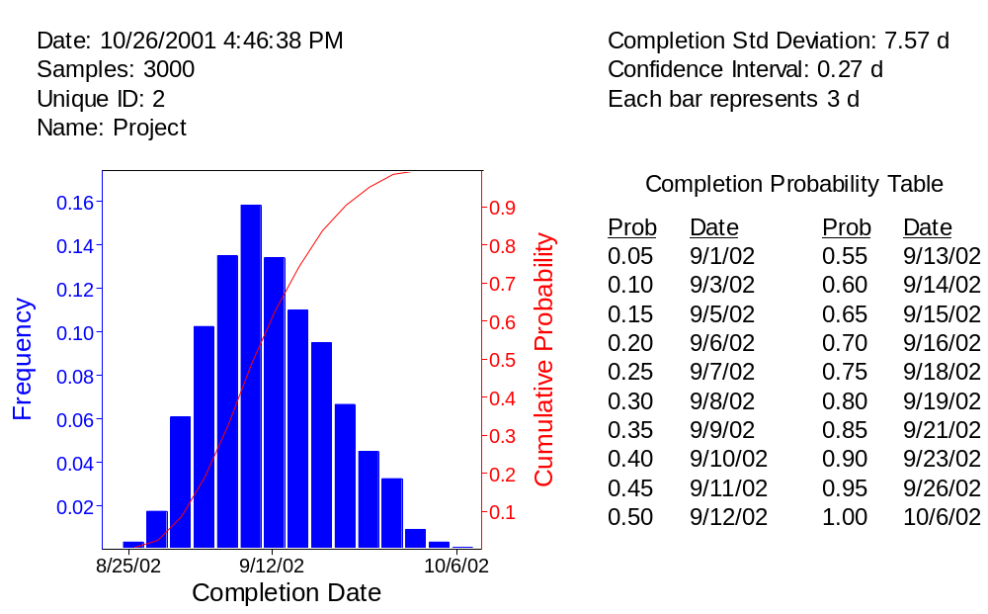
Handling Statused Activities (continued)
After changing the risk ranges to reflect progress,
expected completion is 9/12

Slide 51
Probabilistic Branching
Many projects have points where there is a possibility of failure, a discontinuous event
Have to model the likelihood of the failure and its consequence for the schedule
Called “Probabilistic Branching”
Probabilistic branching is an advanced feature found in Risk+, @RISK, PERTMASTER and Monte Carlo

Slide 52
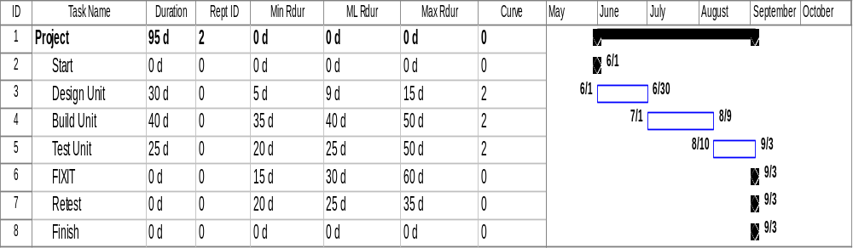
Model the Probabilistic Branch
Typically we do not include failure in schedule
  Add FIXIT and Retest
  Preserve the 9/3 finish date (with 0 duration)
Enter ranges for the new activities

Slide 53
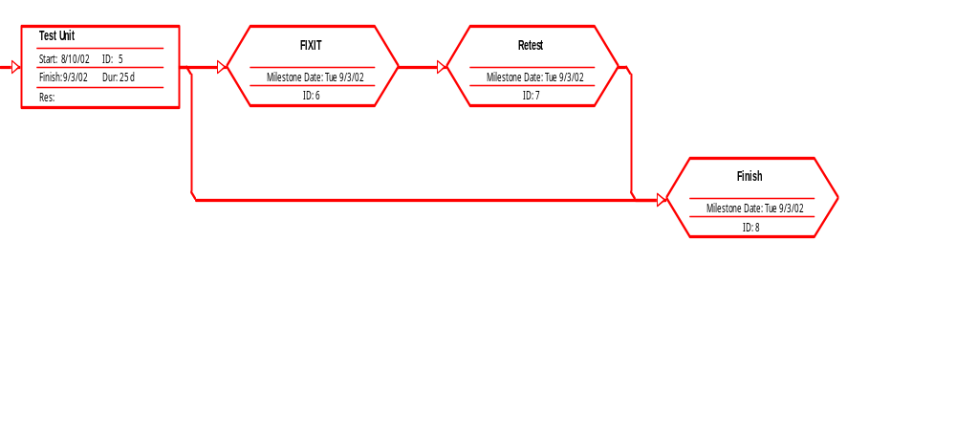
Logic of Probabilistic Branch
Fail 30% Branch
Succeed 70% Branch
New Activities

Slide 54
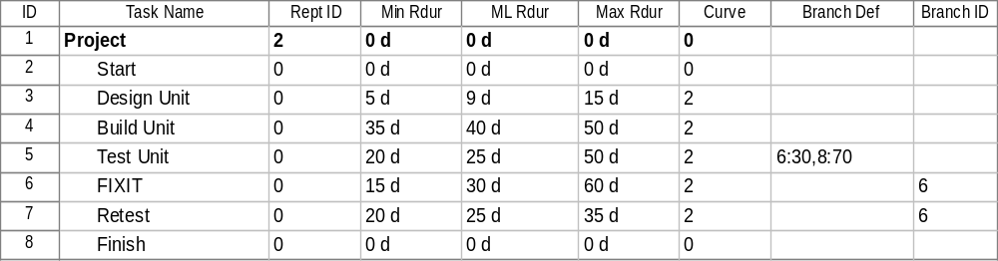
Branching in the Risk Entry Table

Slide 55
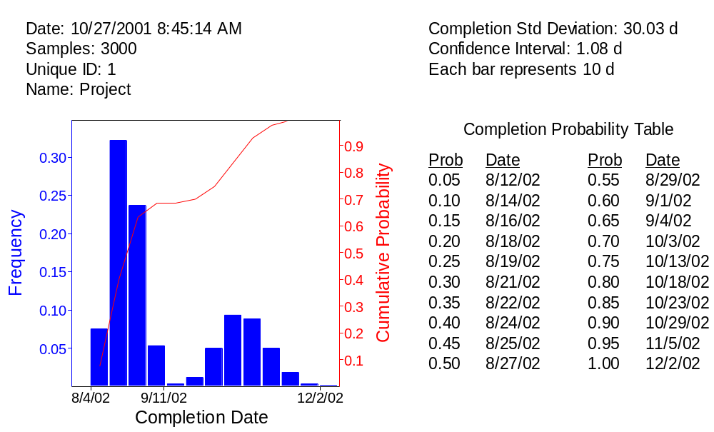
Typical Bi-Modal Result Distribution
Success
Failure

Slide 56
Conditional Branching
Contingency Planning Problem
Propulsion System Alternative A is preferred by customer
  Alternative A is new and risky
Alternative B is the back up, contingency plan
  Acceptable, not preferred
We care about the schedule, too
How long do we stick with Alternative A and under what condition do we go to Alternative B?
Conditional branching is an advanced feature found in @RISK, Monte Carlo and Risk+

Slide 57
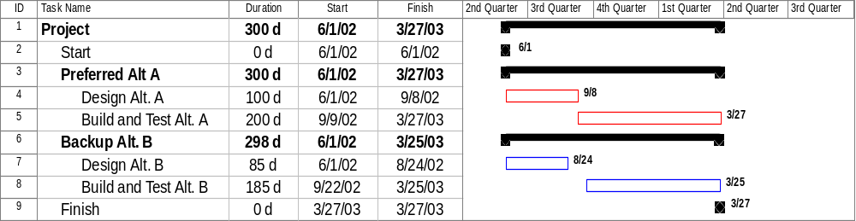
Schedule with Alternatives A & B
Build and Test Alt. B SNET 9/22, the day after the decision about Alt. A

Slide 58
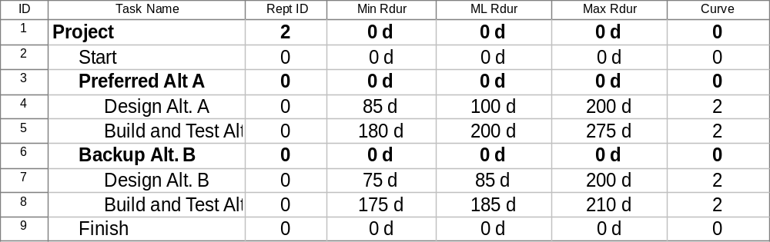
Risk Information for Alternatives A and B
Alternative A has Wider Ranges, Longer Design Time
Alternative B is Less Desirable but Less Risky

Slide 59
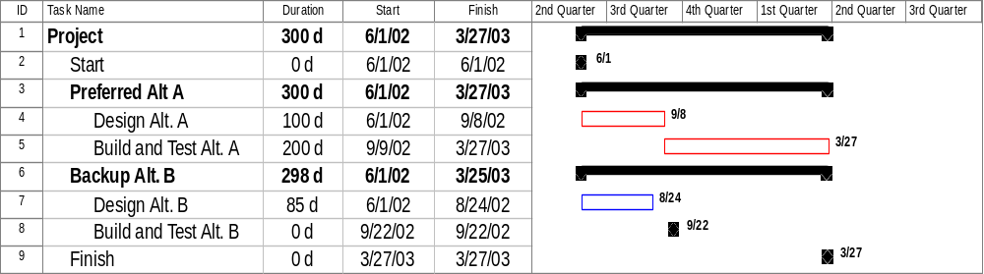
What Happens if there is No Backup Alt. B?
Zero out Build and Test Alt. B so Alt. A is the only one

Slide 60
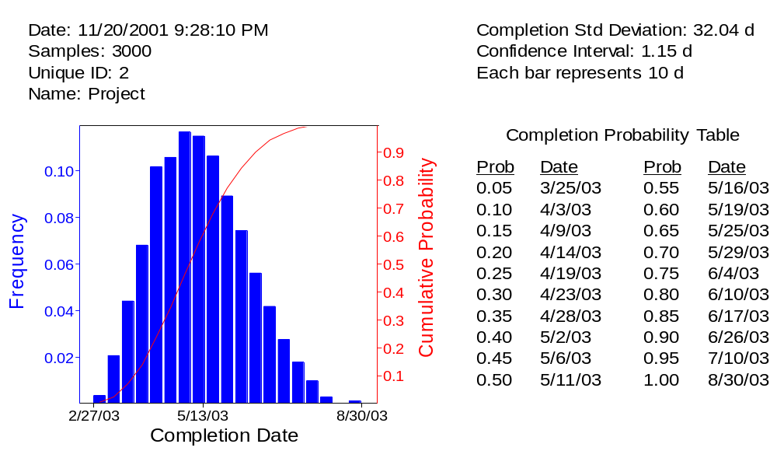
If Must Go with Alt. A, (if there is No Alt. B),
80% Date is 6/10/03

Slide 61
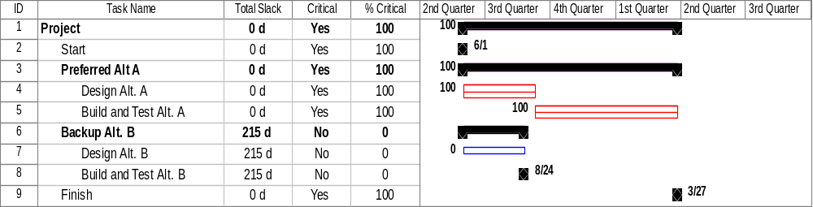
If No Alternative B,
Alternative A is 100% Likely

Slide 62
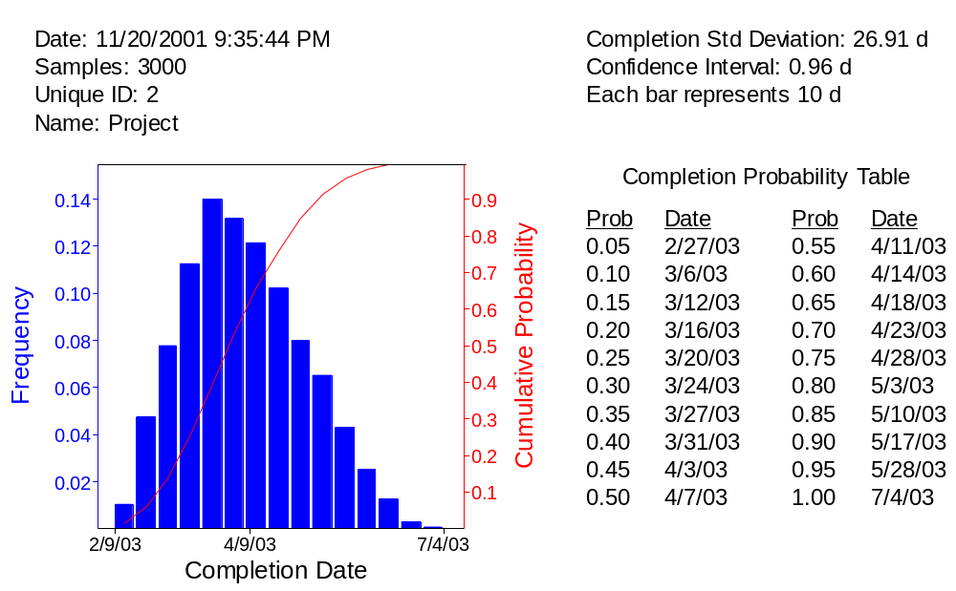
Choosing Alt. B if Alt. A Design is Later than 9/21 – 80% Date is Now 5/3/03

Slide 63
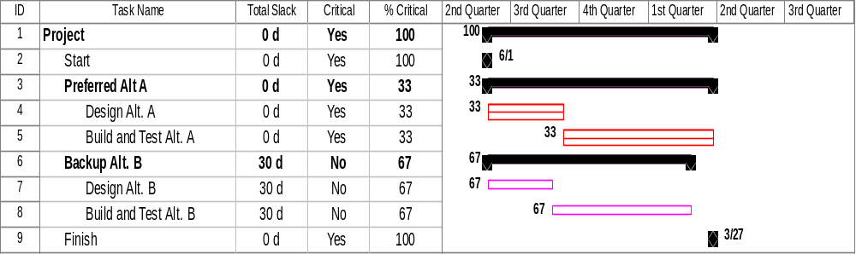
Switch to Alt. B if Design on Alt. A is Later than 9/21 – Which Technology is Used?
Plan A is Chosen only 33% of the Time
Plan B is Chosen 67% of the Time

Slide 64
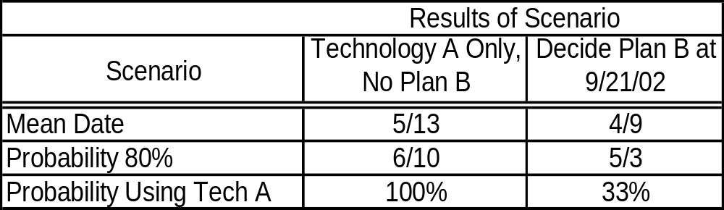
Summary of Conditional Branch Exercise

Slide 65
Causes of Correlation
Correlation between activity durations
  When two activities’ durations “move together”
  They are driven by a common risk driver
Software Designing
State-of-the- Art Technology
Software Coding

Slide 66
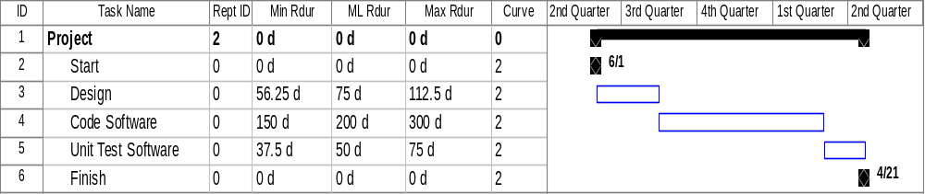
For Ease of Data Entry,
Use Quick Setup
For expediency, use risk banding
  Low = -25%
  High = +50%
  Distribution = triangular
Correlation is an advanced feature found in @RISK, PERTMASTER and Risk+. Monte Carlo has rudimentary correlation

Slide 67
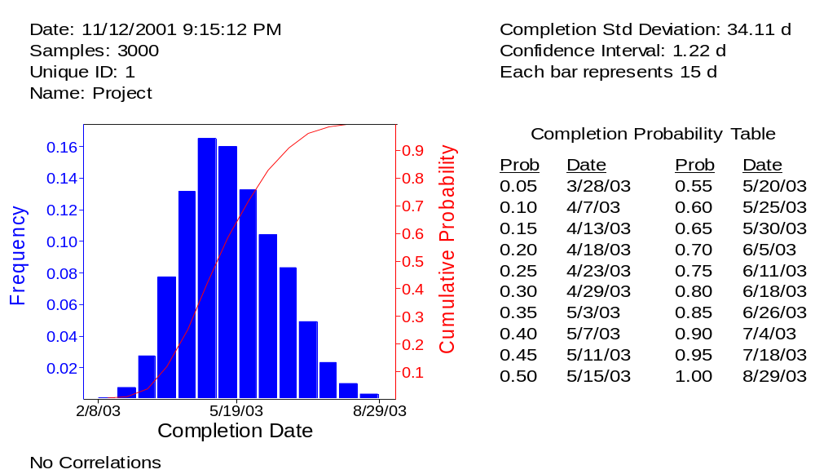
Simulation With No Correlation
Sigma 34.1 days
Range 2/8 – 8/29/03

Slide 68
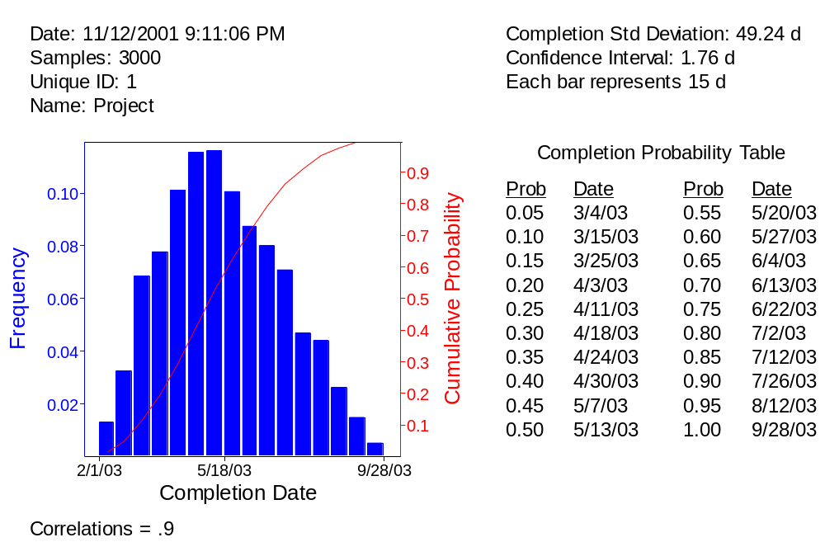
Results of Correlated Durations
Sigma 49.2 d, Larger than 34.1 d
Range 2/1 – 9/28, Wider than 2/8 – 8/28

Slide 69
Correlation Methods
Most software uses Spearman rank order correlation
  @RISK for Project, PERTMASTER, Excel and Crystal Ball for Excel
  No known relationship to Pearson correlation
Risk+ has just adopted correlation and uses Pearson’s approach
  This is what we think of when we specify correlation
  Uses a Lurie-Goldberg iteration for non-normal distributions
Monte Carlo just uses perfect positive correlation

Slide 70
This Correlation Matrix is Not Feasible
Correlation Matrix may be infeasible
Eigenvalue (determinant) test used to test feasibility
 | Design | Code | Test
Design | 1.0 | .9 | .9
Code | .9 | 1.0 | .2
Test | .9 | .2 | 1.0

Slide 71
Software Performs Test
Alerts the user
  The matrix is inconsistent with the natural world
  These coefficients could not coexist
The program then offers to adjust the matrix so that it just barely passes the test
  The user can see where the problems are
  Risk+ allows the user to indicate the relative confidence of the coefficients, and adjusts mainly the less confident ones

Slide 72
Schedule Risk Analysis Summary
Introduction
Activity distributions and data entry
Risk along a schedule path
Risk of parallel paths -- the “Merge Bias”
Effect of limited resources
Effect of constraints

Slide 73
Schedule Risk Analysis Summary (continued)
Sensitivity Analysis
“Risk Critical Path”
Risk in statused schedules
Probabilistic branching
Conditional branching
Correlations

Slide 74
Advanced Project Schedule Risk Analysis
Presented by
David T. Hulett, Ph.D.
Hulett & Associates, LLC
Project Management Consultants
Los Angeles, CA
info@projectrisk.com
www.projectrisk.com
(310) 476-7699
© 2002 Hulett & Associates, LLC.
Notes:
Project Risk Analysis and Management Three-Day Course
Presented by
David T. Hulett, Ph.D.
Senior Vice President
Project Risk Management
© 2000 International Institute for Learning, Inc.
For
Ericsson Telecommunicatie b.v.
June 5-7, 2000

